Slide 1
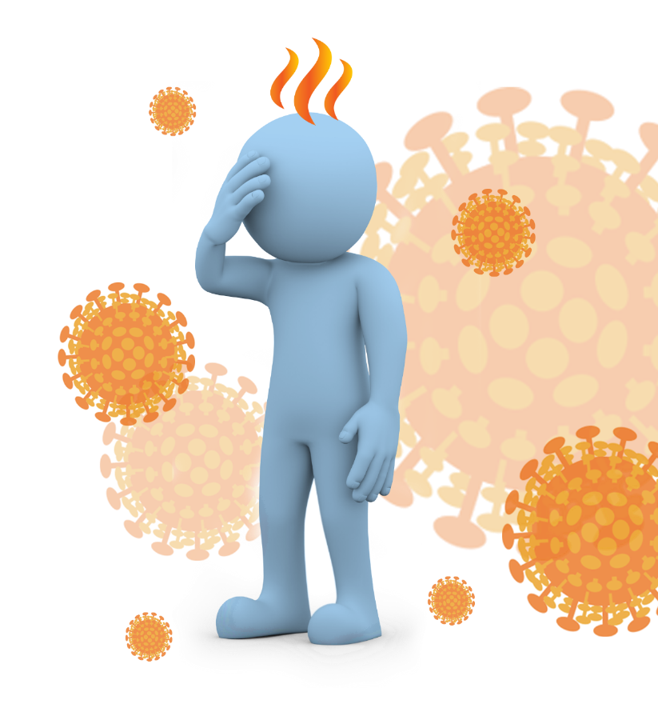
Coronavirus Disease 2019 (COVID-19)
What you need to know
Version 8.0
Disclaimer: This presentation has been developed for educational purposes only. It is not a substitute for professional medical advice. Should you have questions or concerns about any topic described here, please consult your medical professional.
© 2020 AEA International Holdings Pte. Ltd. All rights reserved.
Unauthorized copy or distribution is prohibited.
Notes:
Content was last updated by International SOS – date 21st September 2020
Content is subject to change. Version 8.0 Feedback and comments email to healthpromotion@internationalsos.com

Slide 2
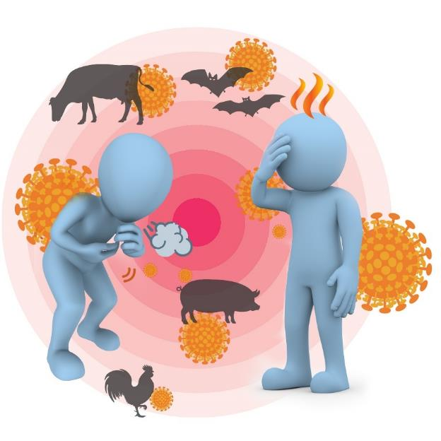
Severe acute respiratory syndrome coronavirus 2 (SARS-CoV-2) causes COVID-19
SARS-CoV-2 is a new virus.
The first cases were identified in people with pneumonia in Wuhan, China, in late December 2019.
It probably started in animals but is now spreading between people.
As this virus is new, we are learning more all the time, and what we know now may change.

Slide 3
COVID-19 pandemic
The World Health Organization (WHO) declared the situation a pandemic on 11 March 2020 signifying
Widespread human-to-human transmission
Large number of affected countries
Although there is a lot we don’t know yet about this new virus, we can still prevent the disease.

Slide 4
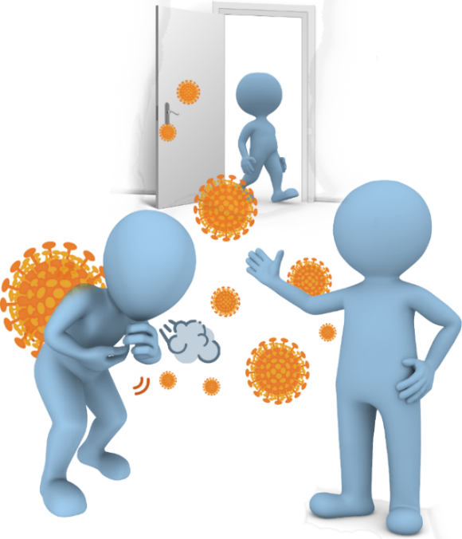
How is COVID-19 spread?
Most people are being infected from other people, when in close contact.
It probably spreads the same way as colds and flu – through droplets which are created when we talk, cough and sneeze.
People in close contact can get infected when these droplets enter the nose, eyes or mouth or when the infected droplets are inhaled.
Touching contaminated objects puts the droplets onto your hands. If you touch your face the droplets can enter your nose / eyes / mouth.
Infected people with minimal or no symptoms can spread COVID-19.

Slide 5
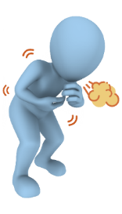
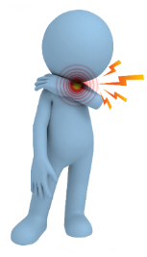
Symptoms start like many other illnesses
Common symptoms include:
Fever
Cough
Sore throat
Fatigue
Shortness of breath
Symptoms start about one day after exposure, but can be as long as 14 days. Most people develop symptoms within 5-6 days.

Slide 6
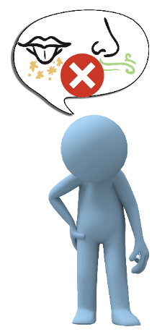
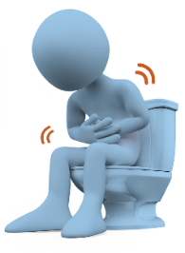
It can also cause many other symptoms, including
Headache / muscle aches
Sudden loss of sense of smell and taste
Runny/stuffy nose
Diarrhoea
Rash
Some people have no symptoms, most have a mild illness. It can be severe and sometimes fatal.
Many patients recover fully in about 2 weeks. In others, some symptoms like breathlessness and fatigue may continue for weeks and months.

Slide 7
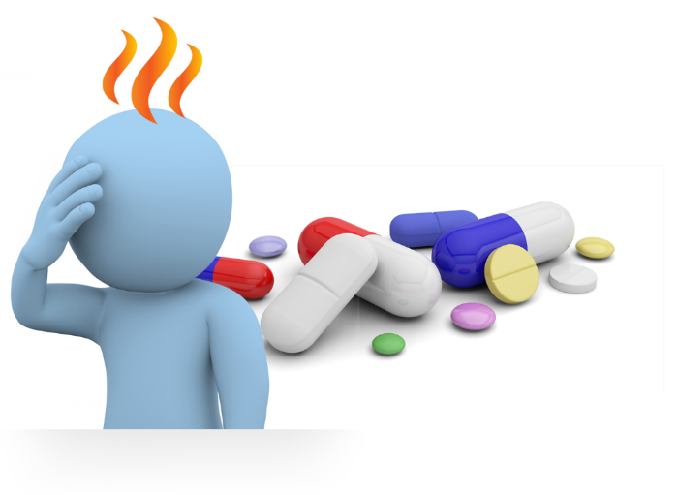
Diagnosis and treatment
Because symptoms are similar to many other illnesses, tests are needed to make the diagnosis (nose/ throat swab, blood test).
There is no specific treatment.
Mild symptoms can be treated at home with medicines to lower the fever, or relieve pain.
If symptoms are more severe, treatment in hospital is required.

Slide 8
Prevention
Reduce the spread of infection
Wear a face mask (or cloth covering nose and mouth) in when in public.
If you have any symptoms even if only mild, stay home. Seek medical advice following local guidelines.
Wash your hands frequently with soap and water.
Use alcohol-based hand sanitiser when soap and water are not readily available.
Cover your coughs and sneezes. Do not use your hands, instead use a tissue or your upper sleeve. Immediately throw the tissue in a bin and wash your hands.

Slide 9
Prevention
Reduce the spread of infection
Avoid touching shared objects (light switches, handrails, door handles etc) as much as possible. If you must touch such objects, wash your hands or use sanitiser promptly afterwards. Ensure you do not touch your face.
Clean and disinfect frequently touched surfaces each day, more often if you think they’ve been contaminated. Use normal cleaning supplies.
Do not share food, drinks and personal items including mobile phones.
Do not travel if you are sick.

Slide 10
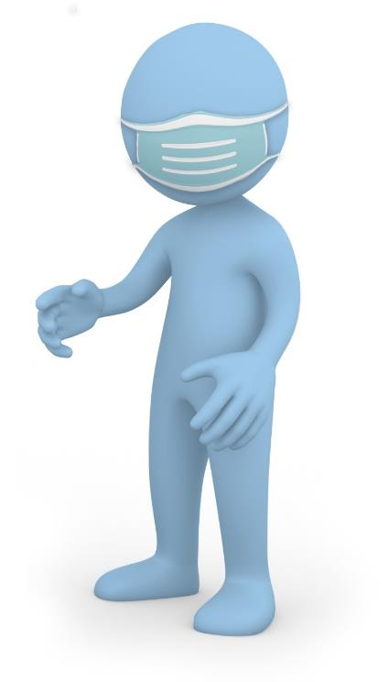
More on use of masks
Follow local guidelines
Wear a mask:
When in face-to-face contact with others.
When social distancing cannot be achieved.
If you are in the high-risk groups.
Within a healthcare facility or other public spaces.
Wear a medical mask
When coughing or sneezing.
When caring for a sick person.
Masks alone don’t protect – they should be used along with other hygiene measures.
Follow manufacturer’s advice for using the mask.
Mask reduces the risk of the wearer spreading the virus.

Slide 11
Prevention
Avoid potential exposure
Stay home as much as practical.
Maintain social /physical distance – keep 1-2 metres (3-6 feet) away from others, even if they appear well.
Avoid crowded places.
Maintain social distance when greeting visitors. Avoid shaking hands, kissing or hugging.
Minimise gatherings with friends and family.

Slide 12
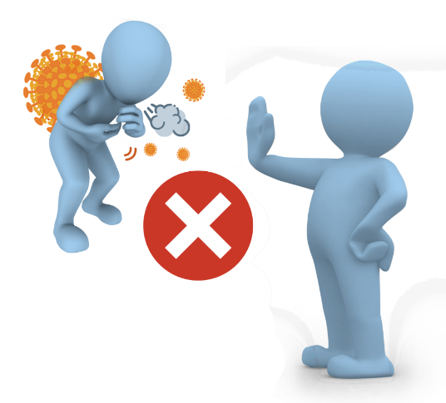
Prevention
Avoid potential exposure
Work from home, where possible.
As far as possible, use private transport. Avoid public transport.
Keep away from people who are sick – don’t let them cough or sneeze on you.
Avoid visiting hospitals and other medical facilities unless you need medical care.

Slide 13
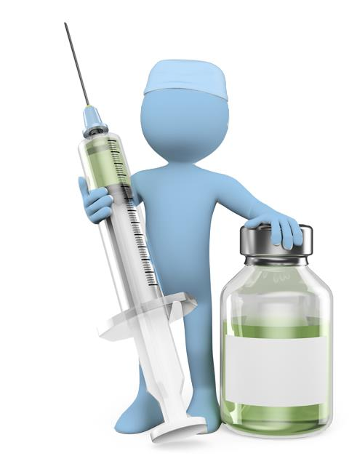
Are you ready for COVID-19?
Prepare yourself and your family:
Monitor the situation. Know your local health helpline numbers and be aware of the local procedures.
Ensure you have access to essentials such as food, water, household supplies and medicines.
Speak to your doctor about any chronic medical conditions you may have, and get them under optimal control.
Keep in best possible health. Get the recommended amount of sleep each day, eat a healthy diet, and keep up regular physical activity.
Consider how you will manage if authorities impose restrictions for a couple of weeks.
Plan to be able to look after a sick household member.
Get the flu shot – this will reduce the risk of seasonal flu and possible confusion with COVID-19 symptoms.
Influenza
Vaccine
Notes:
Monitor the situation. Know your local health helpline numbers, what to do if you come in contact of a COVID-19 case, or if you develop symptoms.
Speak to your doctor about any chronic medical conditions you may have, and get them under optimal control. Ensure you have adequate supplies of any necessary equipment and medication.
Consider how you will manage if authorities impose restrictions for a couple of weeks.
Plan how you will reduce your risk of infection as the outbreak reaches your area - limiting your contact with others, restricting visitors to your home, stepping up cleaning.
Ensure you have access to essentials such as food, water, household supplies and medicines.
Plan to be able to look after a sick household member - identify an area in the home where they can be as separated from the rest of the family as possible, limiting direct contact, having a separate sleeping area and bathroom if possible.
WHO guidance on social distancing - https://www.who.int/news-room/q-a-detail/q-a-coronaviruses
US CDC guidance: https://www.cdc.gov/coronavirus/2019-ncov/about/transmission.html

Slide 14
What to do if you get sick
Stay home if you have mild symptoms. Do not go to work.
Minimise contact with people in the household until you have recovered. Monitor your condition. Follow local guidelines for self-isolation.
Cover your coughs and sneezes – use a tissue or a mask if available – and wash your hands with soap and water.
Seek medical attention if your symptoms worsen. Make an appointment.
Wear a mask in case you need to visit a doctor. Use private transport as much as possible.

Slide 15
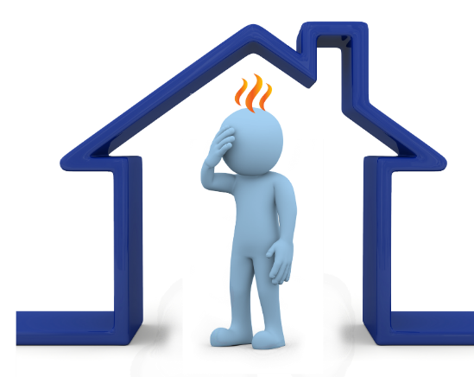
Screening and contact tracing
Is important to stop the spread of the virus
“Screening” may be done at entry points to detect sick people. You may be asked where you have been, and your temperature may be taken.
Health authorities may perform “contact tracing” – identifying people who have been in contact with someone with COVID-19.
These ‘contacts’ may be asked:
To stay at home for 14 days so they don’t infect other people.
To monitor their health for 14 days in case they develop symptoms.
Follow the advice of health authorities.

Slide 16
Coping with stress during the COVID-19 outbreak
COVID-19 can be stressful, the effects can be both physical and emotional.
Things you can do to reduce stress:
Take breaks from listening to, watching or reading about COVID-19 frequently, including social media.
Focus on the facts of COVID-19 and understand the risk to yourself and those you care about.
Separate facts from rumours. Gather information from reliable sources.
Find time to unwind. Connect with friends and family.
If stress continues to hamper your daily activities, talk to a doctor, or someone you can trust.
Keep yourself in the best possible health. Sleep well, eat healthy and be physically active.
Notes:
WHO guidance on social distancing - https://www.who.int/news-room/q-a-detail/q-a-coronaviruses
US CDC guidance: https://www.cdc.gov/coronavirus/2019-ncov/about/transmission.html

Slide 17
More information on COVID-19
Keep up to date with news and information from the International SOS dedicated website: https://pandemic.internationalsos.com/2019-ncov

Slide 18
Any questions
Disclaimer: This presentation has been developed for educational purposes only. It is not a substitute for professional medical advice. Should you have questions or concerns about any topic described here, please consult your medical professional.
© 2020 AEA International Holdings Pte. Ltd. All rights reserved.
Unauthorized copy or distribution is prohibited.
Notes:
Feedback and comments email to healthpromotion@internationalsos.com

